Slide 1
Changed gravel parameterization
Before I was filtering out when a resource was greater.
I removed that step
Initial inference is many many more links
Pruned is still lots of additional links
Neutral correction results in higher TPR, Higher FPR, lower True Negative, similar False Negative
Essentially, predicts more links from beginning. Still eliminates a lot of the false ones, but end result = more links.

Slide 2
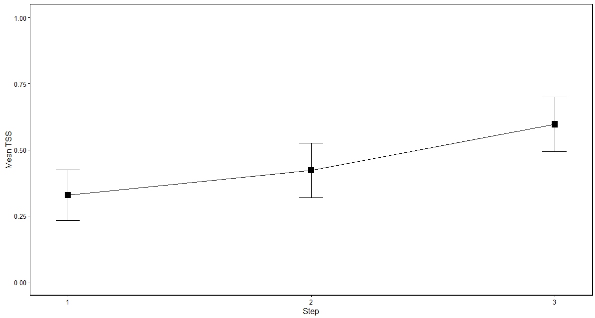
Gravel TSS ~ 3 steps
True Skill Statistic; TSS =
(a*d - b*c)/((a+c)*(b+d))
a = true positive; links both obserevd & predicted
b = false positive; predicted but not observed
c = false negative; observed but not predicted
d = true negative; not predicted, not observed
TSS = 1 = perfect prediction
TSS = -1 = inverse prediction
Step 1 = body mass fxn, step 2 = prune, step 3 = relative abundance

Slide 3
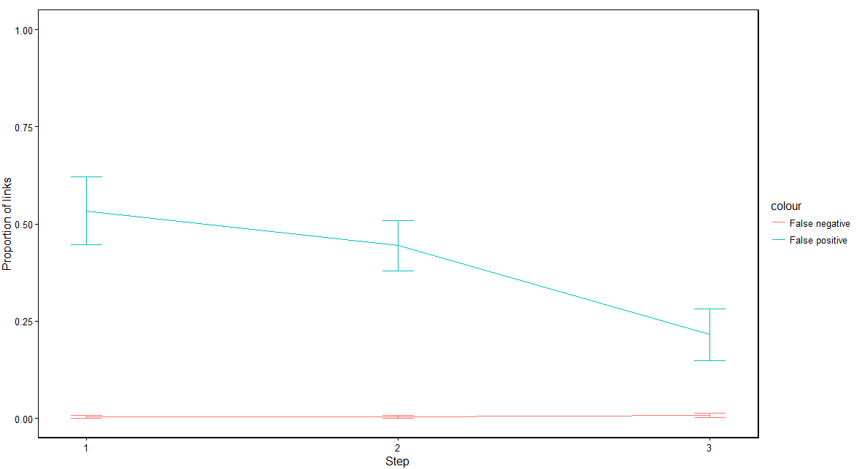
Gravel False Positive False Negative ~ 3 steps

Slide 4
Model | True Positive | True negative | False positive | False negative
WebBuilder | 0.0403 | 0.7291 | 0.2246 | 0.0078
Gravel, step 3 | 0.0385 | 0.7687 | 0.1850 | 0.0060
Mean proportion of links for food webs inferred using the WebBuilder function, and the 3rd step in the modified gravel method

Slide 5
Observed v modelled food web stats
All of the following plots have the following layout:
X = observed statistic
Y = modelled statistic
Red line = trait matching, step 3 (“pruned” and neutral model correction)
Blue line = webbuilder
Black line = 1:1 relationship

Slide 6
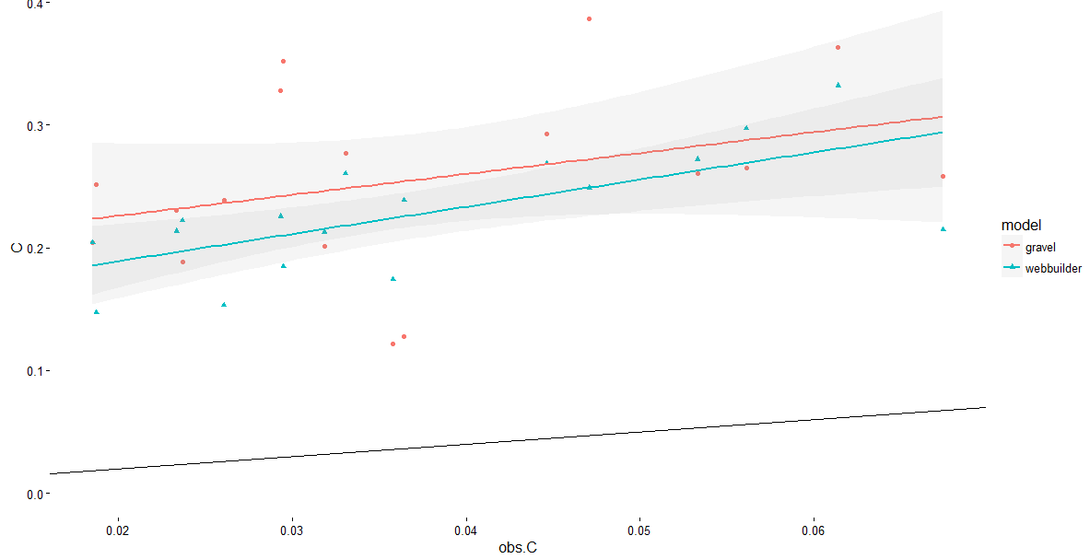
Connectance

Slide 7
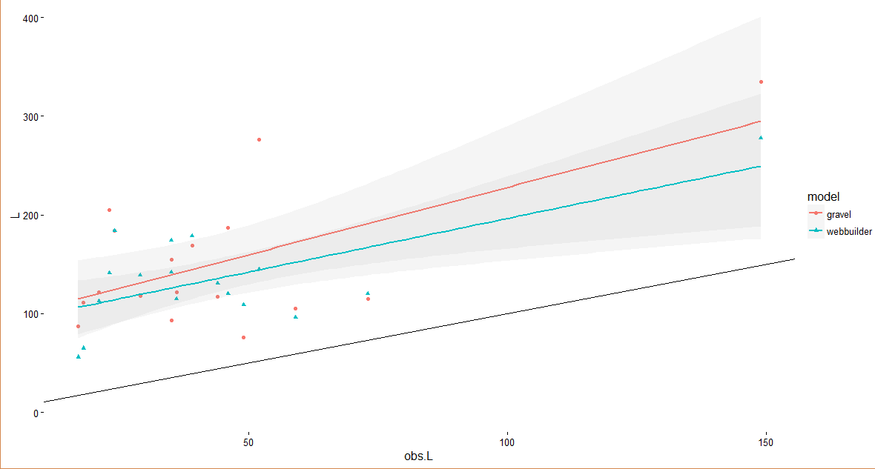
Links

Slide 8
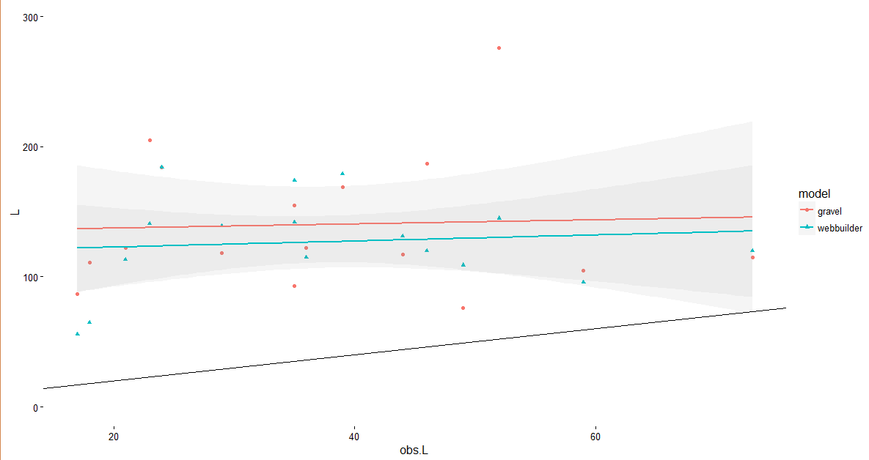
Links (removing potential outlier)

Slide 9
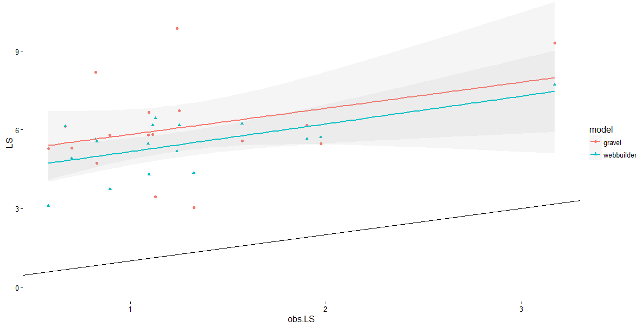
Links per Species

Slide 10
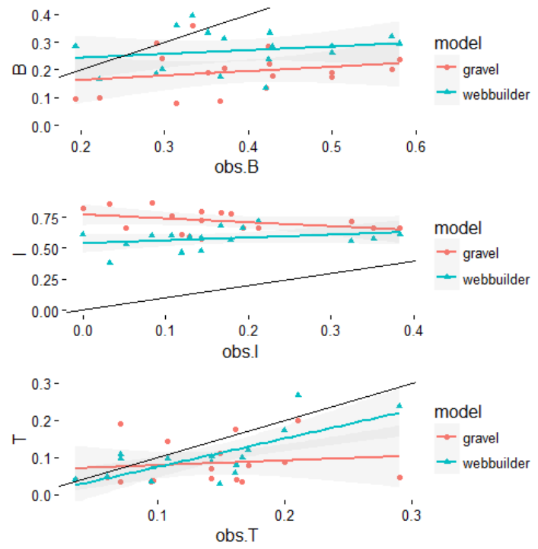
Basal, intermediate, and top species, respectively

Slide 11
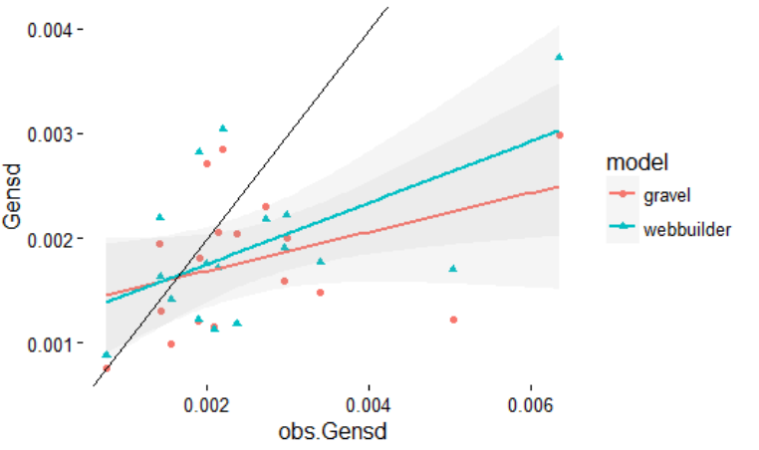
SD of generality (number of resources per node)

Slide 12
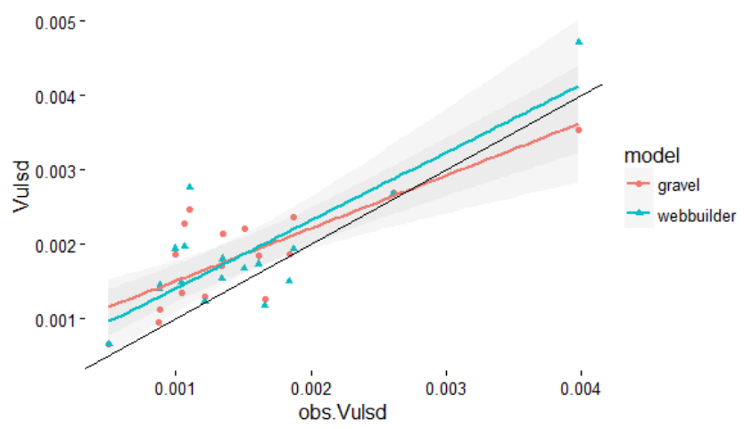
SD of vulnerability (number of consumers per node)

Slide 13
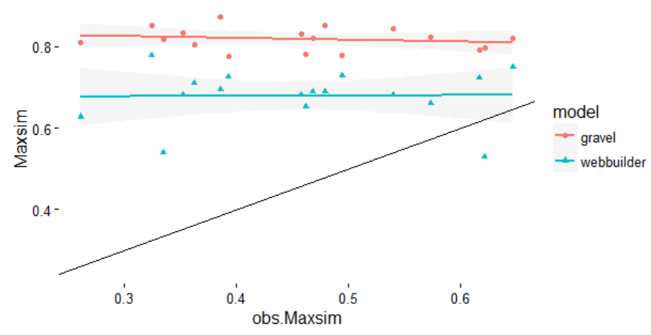
Max similarity (measure of diet overlap)

Slide 14
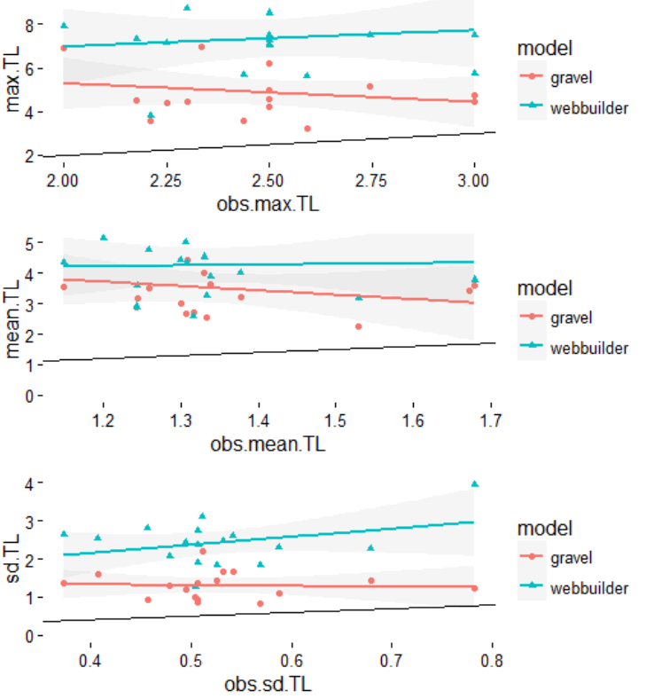
Max, mean, and SD of Trophic level

Slide 15
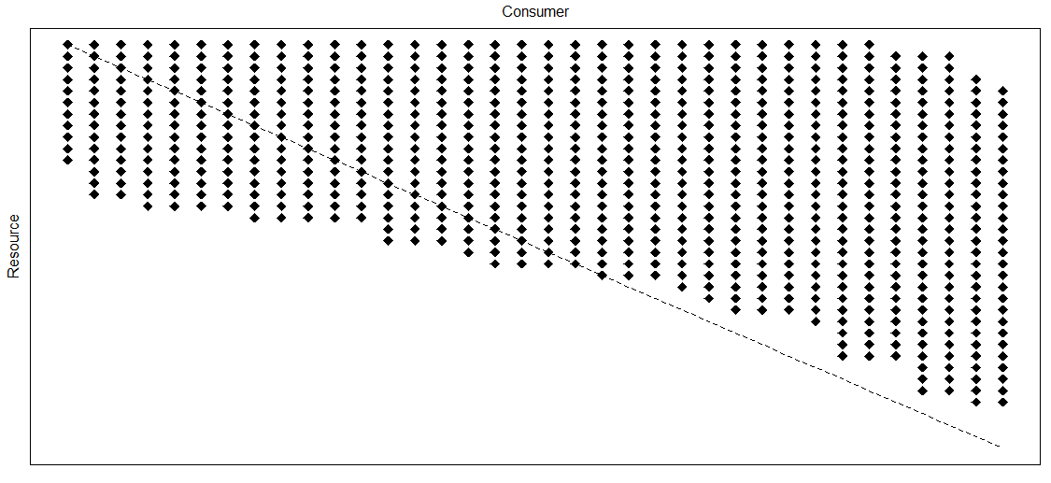
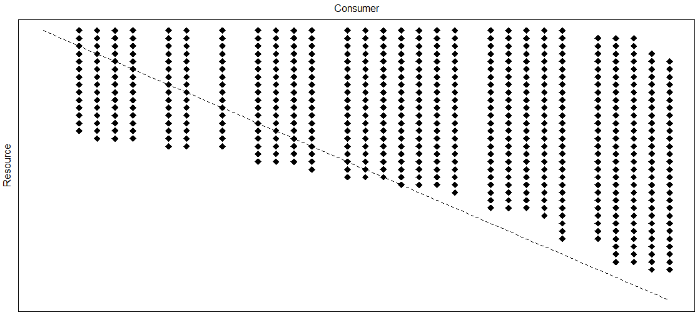
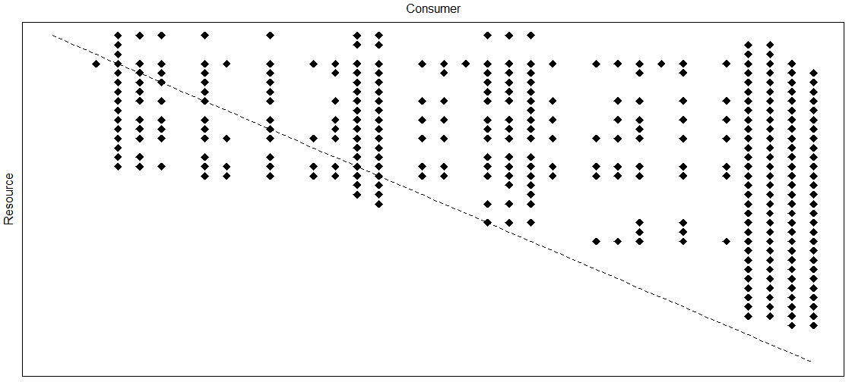
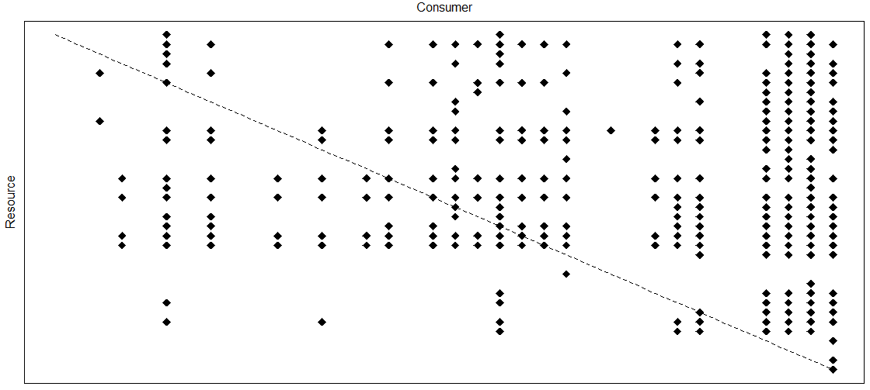
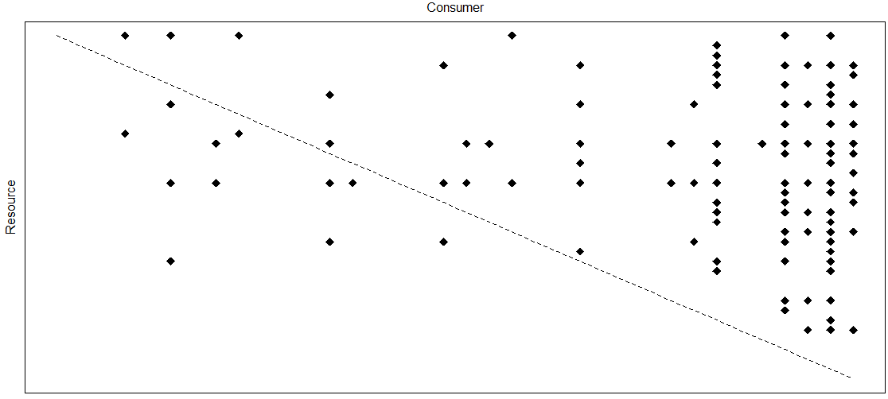
Dempsters Creek
Biomass inferred
Pruned
Relative abundance threshold
Gravel method, 3 steps
WebBuilder
Observed Network

Slide 16
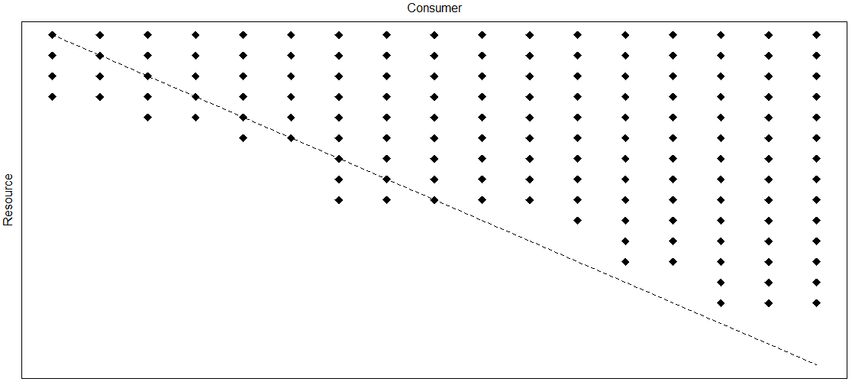
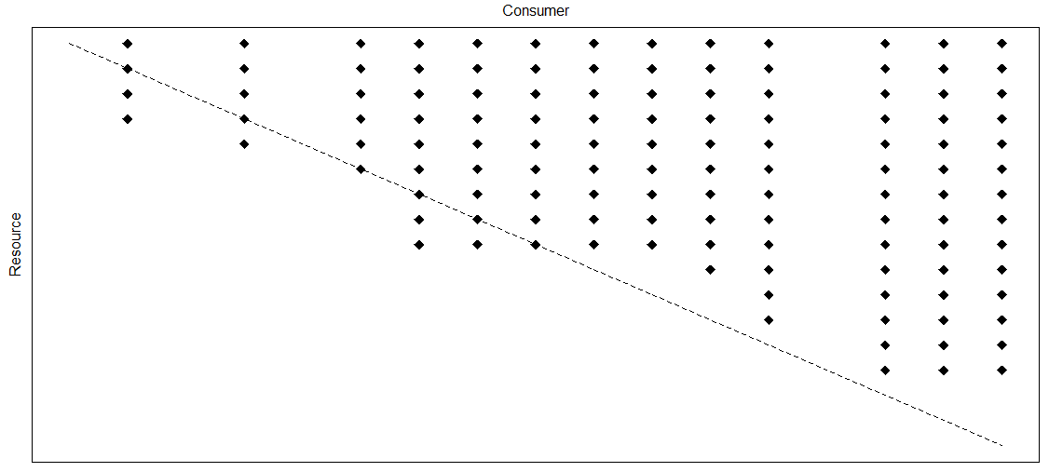
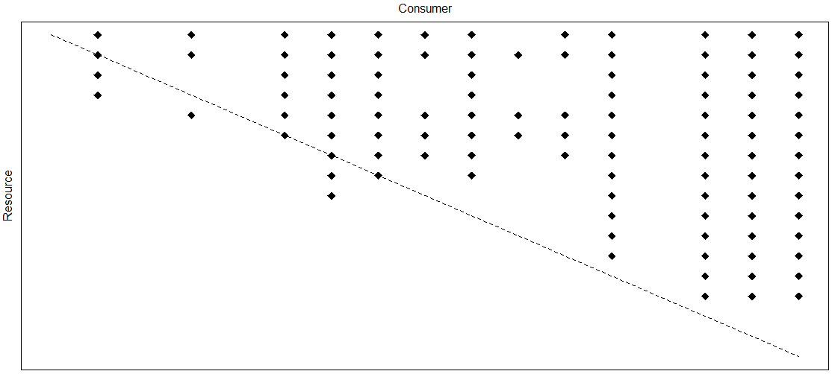
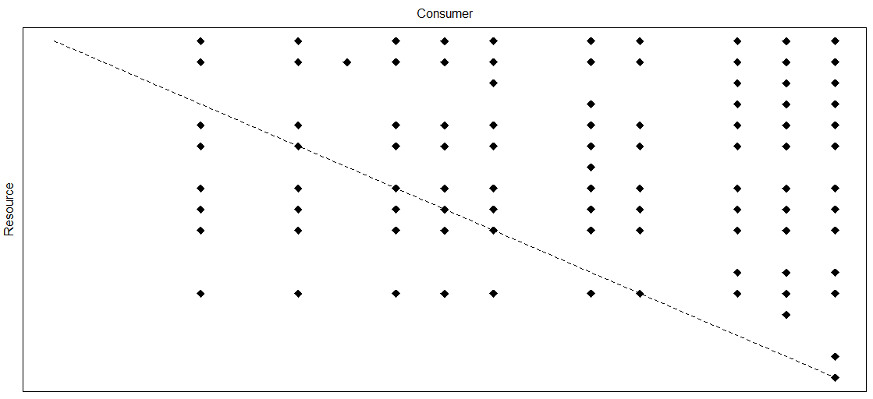
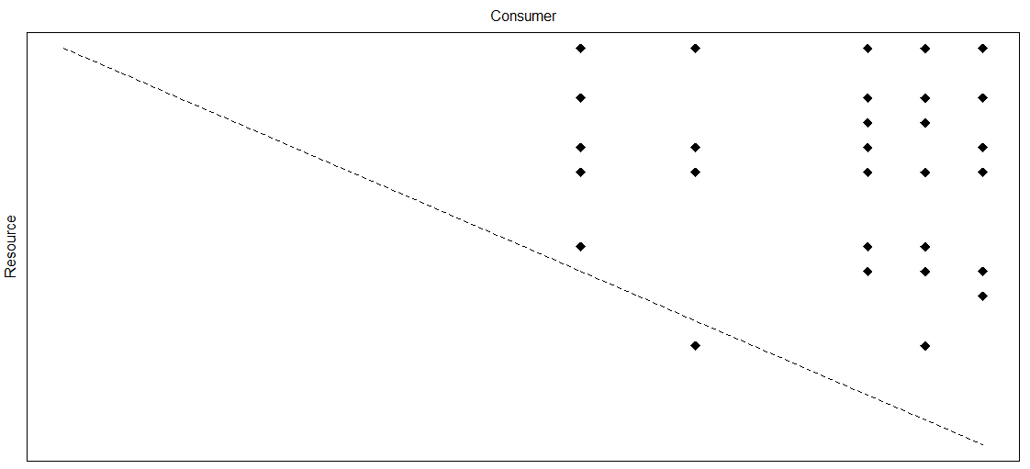
Little Kye Burn Creek
Biomass inferred
Pruned
Relative abundance threshold
Gravel method, 3 steps
WebBuilder
Observed Network

Slide 17
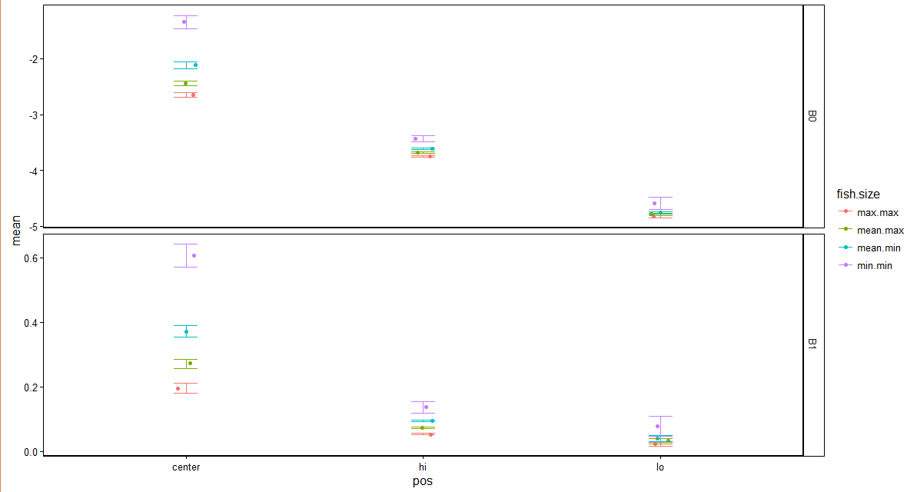
Gravel parameter coefficients ~ 4 fish size
Supplemental. Parameters for gravel model, using 4 different sizes of fish. B0 = intercept of the hi, center, and lo quantile regression. B1 = slope of hi, center and lo quantile regression.
Max.max = maximum max fish length, mean.max = mean maximum fish length, mean.min = mean minimum fish length, min.min = minimum min fish length

Slide 18
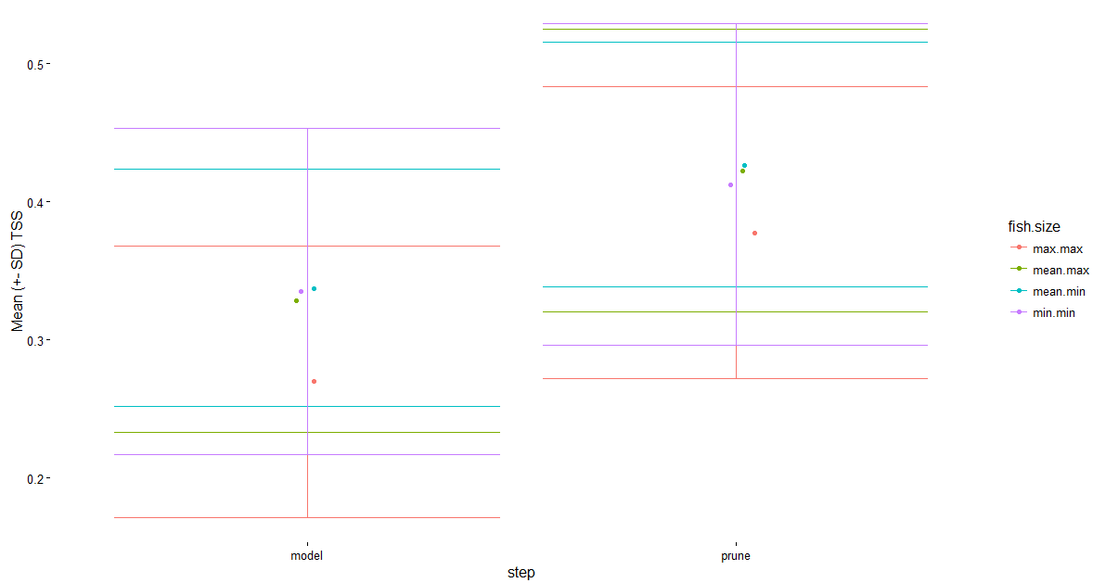
Supplemental. Mean TSS (+- SD), using 4 different sizes of fish. Model = initial inference. Prune = pruning “forbidden links” based on taxonomy.
Max.max = maximum max fish length, mean.max = mean maximum fish length, mean.min = mean minimum fish length, min.min = minimum min fish length
Gravel TSS ~ 4 fish size

Slide 19
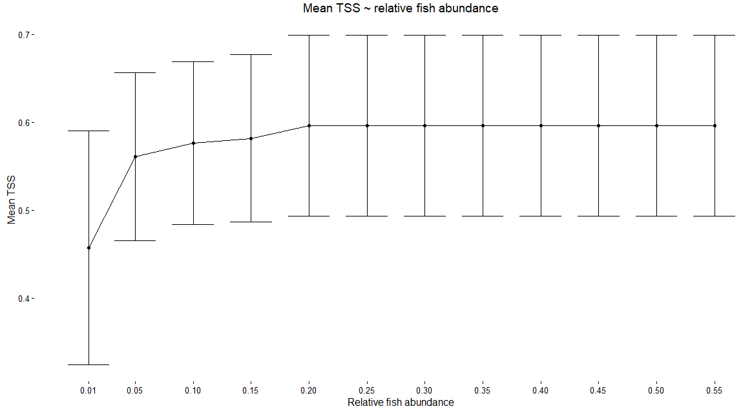
Gravel TSS ~ fish relative abundance values

Slide 20
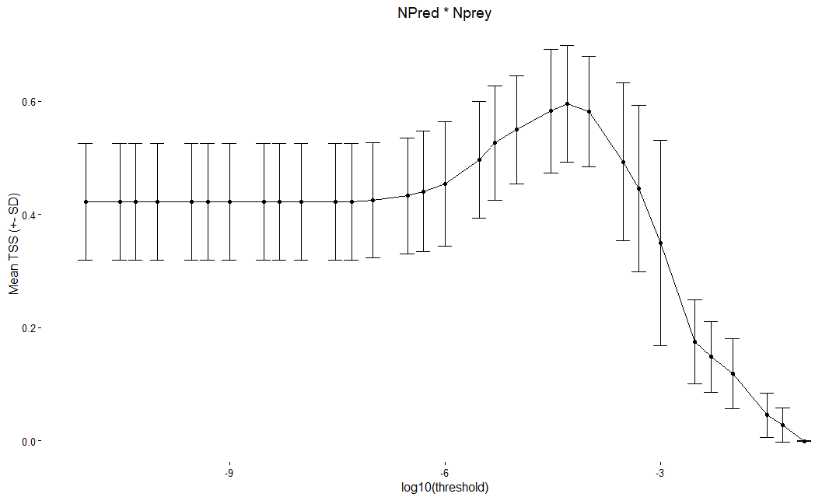
Gravel TSS ~ relative abundance threshold
Supplemental figure (?)
Parameterization of relative abundance correction for Gravel model. TSS maximized at a relative abundance threshold of 5e-05

Slide 21
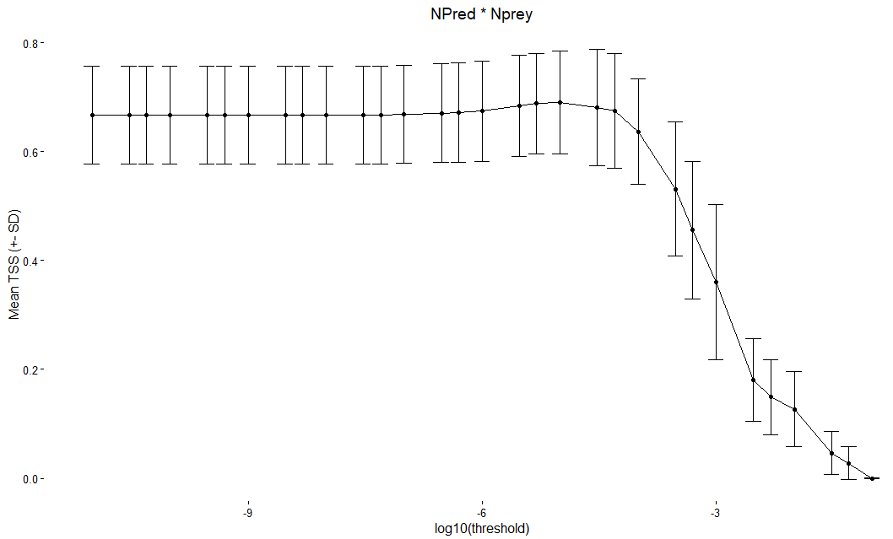
WebBuilder TSS~ relative abundance threshold
Supplemental figure (?)
Parameterization of relative abundance correction for Gravel model. Relative abundance calculated by multiplying relative abundance predator * relative abundance prey

Slide 22
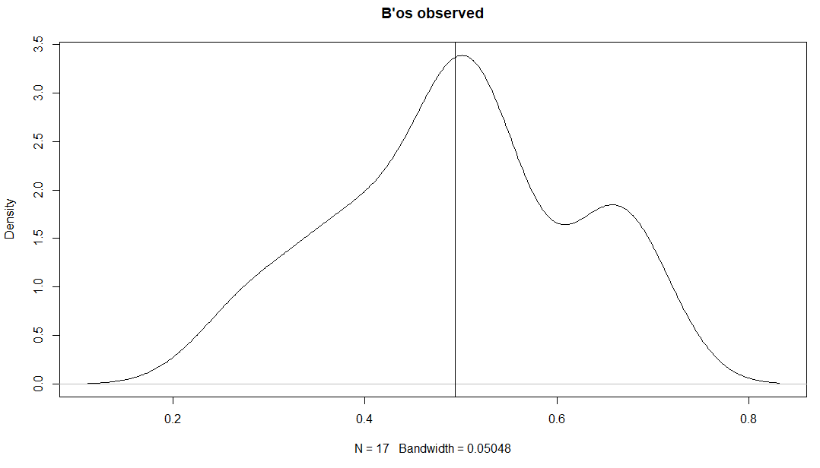
Mean = 0.49

Slide 23
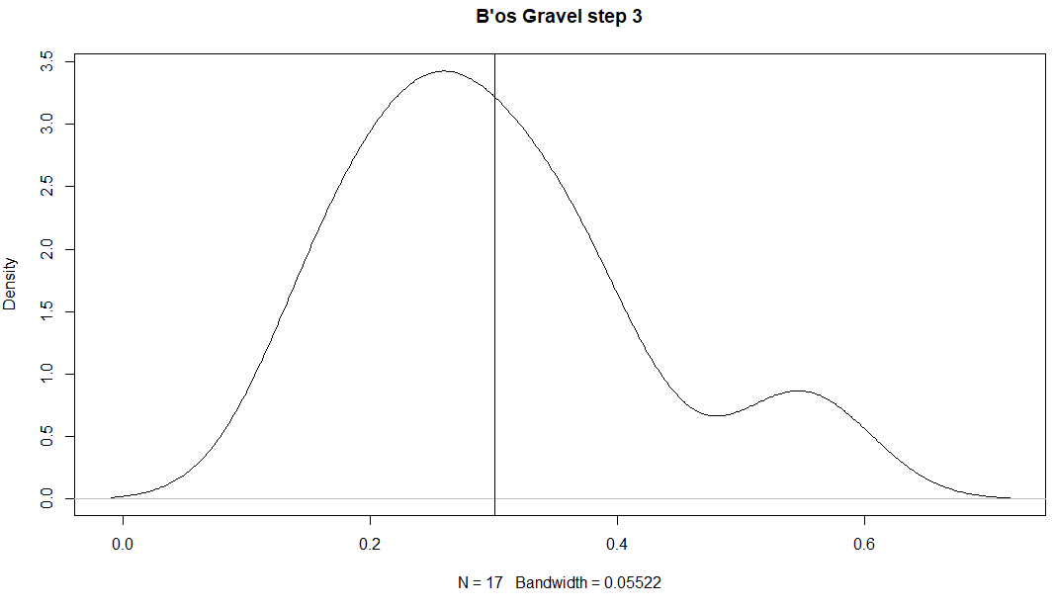
Mean = 0.30

Slide 24
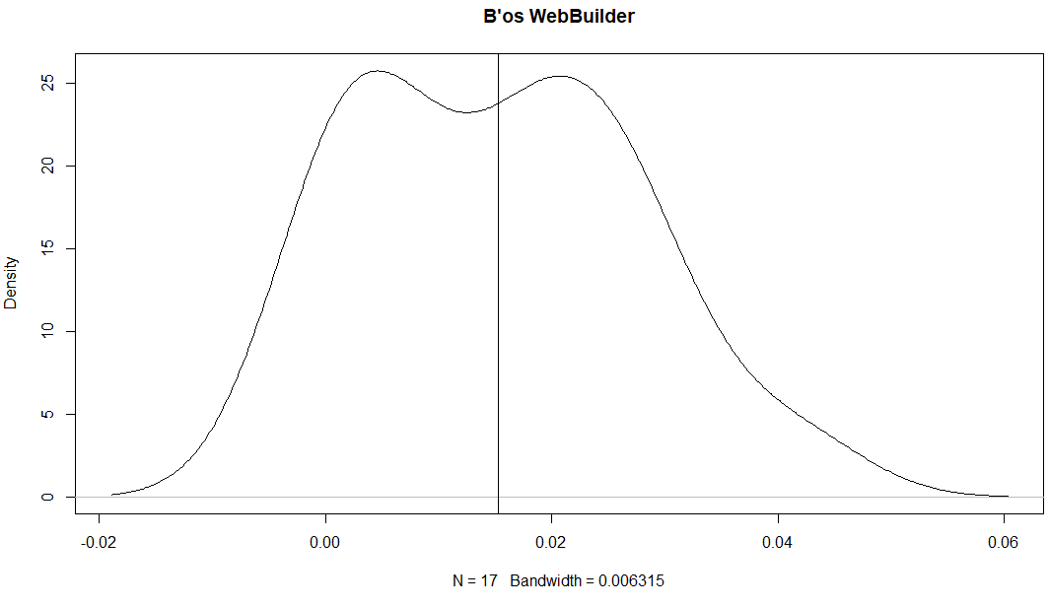
Mean = 0.015

